Slide 1

Multiple Language Translator Using Vosk API
School of Computer Science and Engineering
Department of Computer Science and Engineering
Submitted By: Sanskriti Mandal
23FE10CSE00297
Supervised By: Rajesh Kumar Chaudhary

Slide 2
Outline
Introduction
Literature Review
Problem Statement
Proposed Solution
Objectives
Results

Slide 3
Introduction
In today’s globalized world, communication across different languages is a major challenge
People from different regions often face difficulties in understanding each other due to
language barriers
Traditional translation methods are slow and require manual input
With advancements in Artificial Intelligence, real-time speech recognition and translation have
become possible
These technologies enable seamless and instant communication between individuals speaking
different languages

Slide 4
Introduction
Speech recognition systems convert spoken language into text automatically
When combined with translation systems, they provide real-time multilingual communication
This project focuses on developing a system that integrates speech recognition and translation
The aim is to create a real-time, user-friendly multilingual translator
The system enhances accessibility, communication efficiency, and user convenience

Slide 5
What is Vosk?
Vosk is an offline speech recognition toolkit
Built on Kaldi engine
Converts speech into text in real-time
Works without internet connection
Supports multiple programming languages like Java
Uses hybrid HMM + Deep Neural Network (DNN) models

Slide 6
How Vosk Works
Captures audio from microphone
Extracts features using MFCC (Mel Frequency Cepstral Coefficients)
Uses HMM + DNN for speech recognition
Applies language model to form meaningful words
Uses Viterbi algorithm for best sequence prediction
Generates text in real-time

Slide 7
Features of Vosk
Supports 20+ languages (English, Hindi, Spanish, etc.)
Works offline → no internet required
Provides real-time streaming recognition
Uses pre-trained models (small & large)
Efficient and works on low-resource systems
Ensures privacy (local processing)

Slide 8
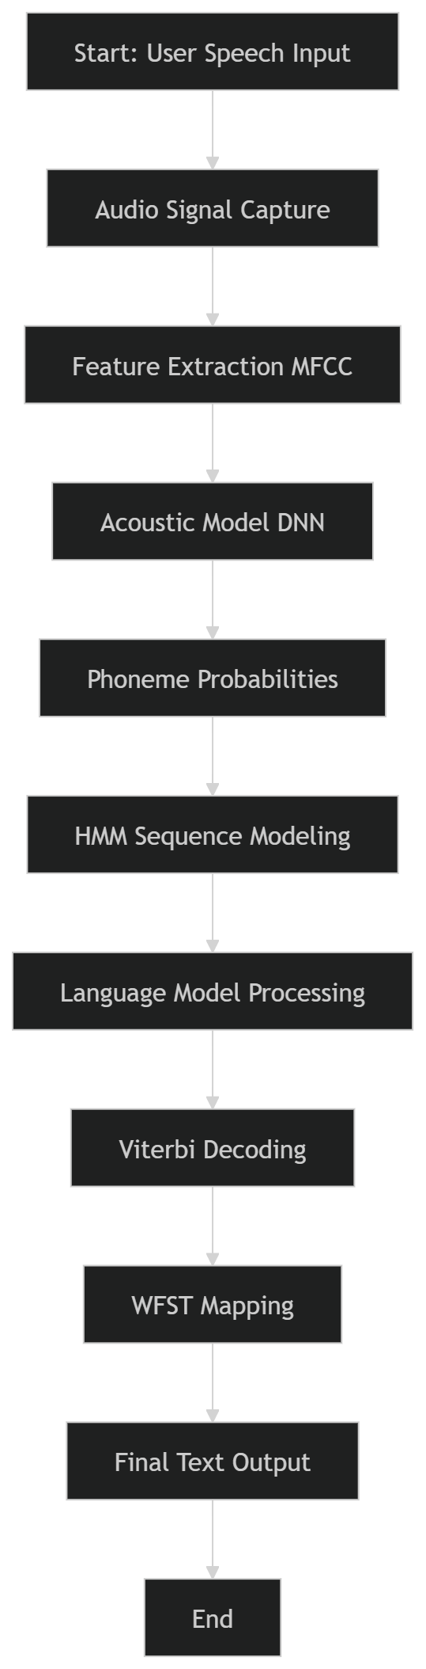
Vosk Algorithm Working
Audio signal is captured and converted into feature vectors (MFCC)
Acoustic model (DNN) predicts probabilities of phonemes (basic speech units)
Hidden Markov Model (HMM) models sequence of phonemes over time
Language model predicts most meaningful word combinations
Viterbi algorithm finds the most probable word sequence
WFST decoder efficiently maps speech → text
“Vosk uses a hybrid model combining Hidden Markov Models (HMM) and Deep Neural Networks (DNN), with Viterbi decoding and WFST-based search.”

Slide 9
Literature Review
Speech recognition systems have evolved significantly using AI and deep learning techniques
Traditional systems were based on Hidden Markov Models (HMM), while modern systems use Deep Neural Networks (DNN)
Kaldi is widely used for building speech recognition systems
Vosk is built on Kaldi and provides offline real-time speech recognition
Research shows that hybrid HMM-DNN models improve accuracy in continuous speech recognition
References:
https://kaldi-asr.org
https://alphacephei.com/vosk/

Slide 10
Literature Review
Machine Translation has evolved from rule-based systems to Neural Machine Translation (NMT)
Modern systems use sequence-to-sequence models and transformers
APIs like LibreTranslate and Google Translate provide real-time translation services
Research shows that NMT improves translation quality and contextual understanding
Real-time translation systems combine speech recognition and machine translation for better usability
References:
https://libretranslate.com/
https://ai.googleblog.com/2016/09/a-neural-network-for-machine.html

Slide 11
Literature Review
Existing systems like Google Translate require internet connectivity
Many systems lack real-time speech-to-speech translation
Privacy concerns arise due to cloud-based processing
Offline tools like Vosk address privacy and latency issues
Research Gap: Need for a system that is:
Real-time
Offline-capable
Multi-language supported
Lightweight and efficient
References:
https://research.google/pubs/pub45610/
https://alphacephei.com/vosk/

Slide 12
Problem Statement
Existing translation systems are not efficient for real-time speech-to-speech communication and often require internet connectivity.

Slide 13
Objectives
To develop a system that converts speech into text in real-time
To translate the recognized text into multiple languages efficiently
To provide real-time output (text and optional speech)
To design a user-friendly and offline-capable translation system

Slide 14
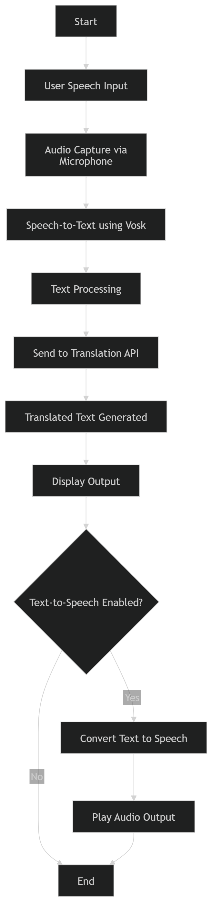
Proposed Methodology
The system captures speech input from the user
Audio is processed using Vosk Speech Recognition
Speech is converted into text format
The text is sent to the translation module
Translated output is displayed to the user

Slide 15
System Workflow
User clicks Start
Microphone captures speech
Vosk converts speech → text
Text is sent to translation API
Translated text is generated
Output is displayed (and optionally spoken)

Slide 16
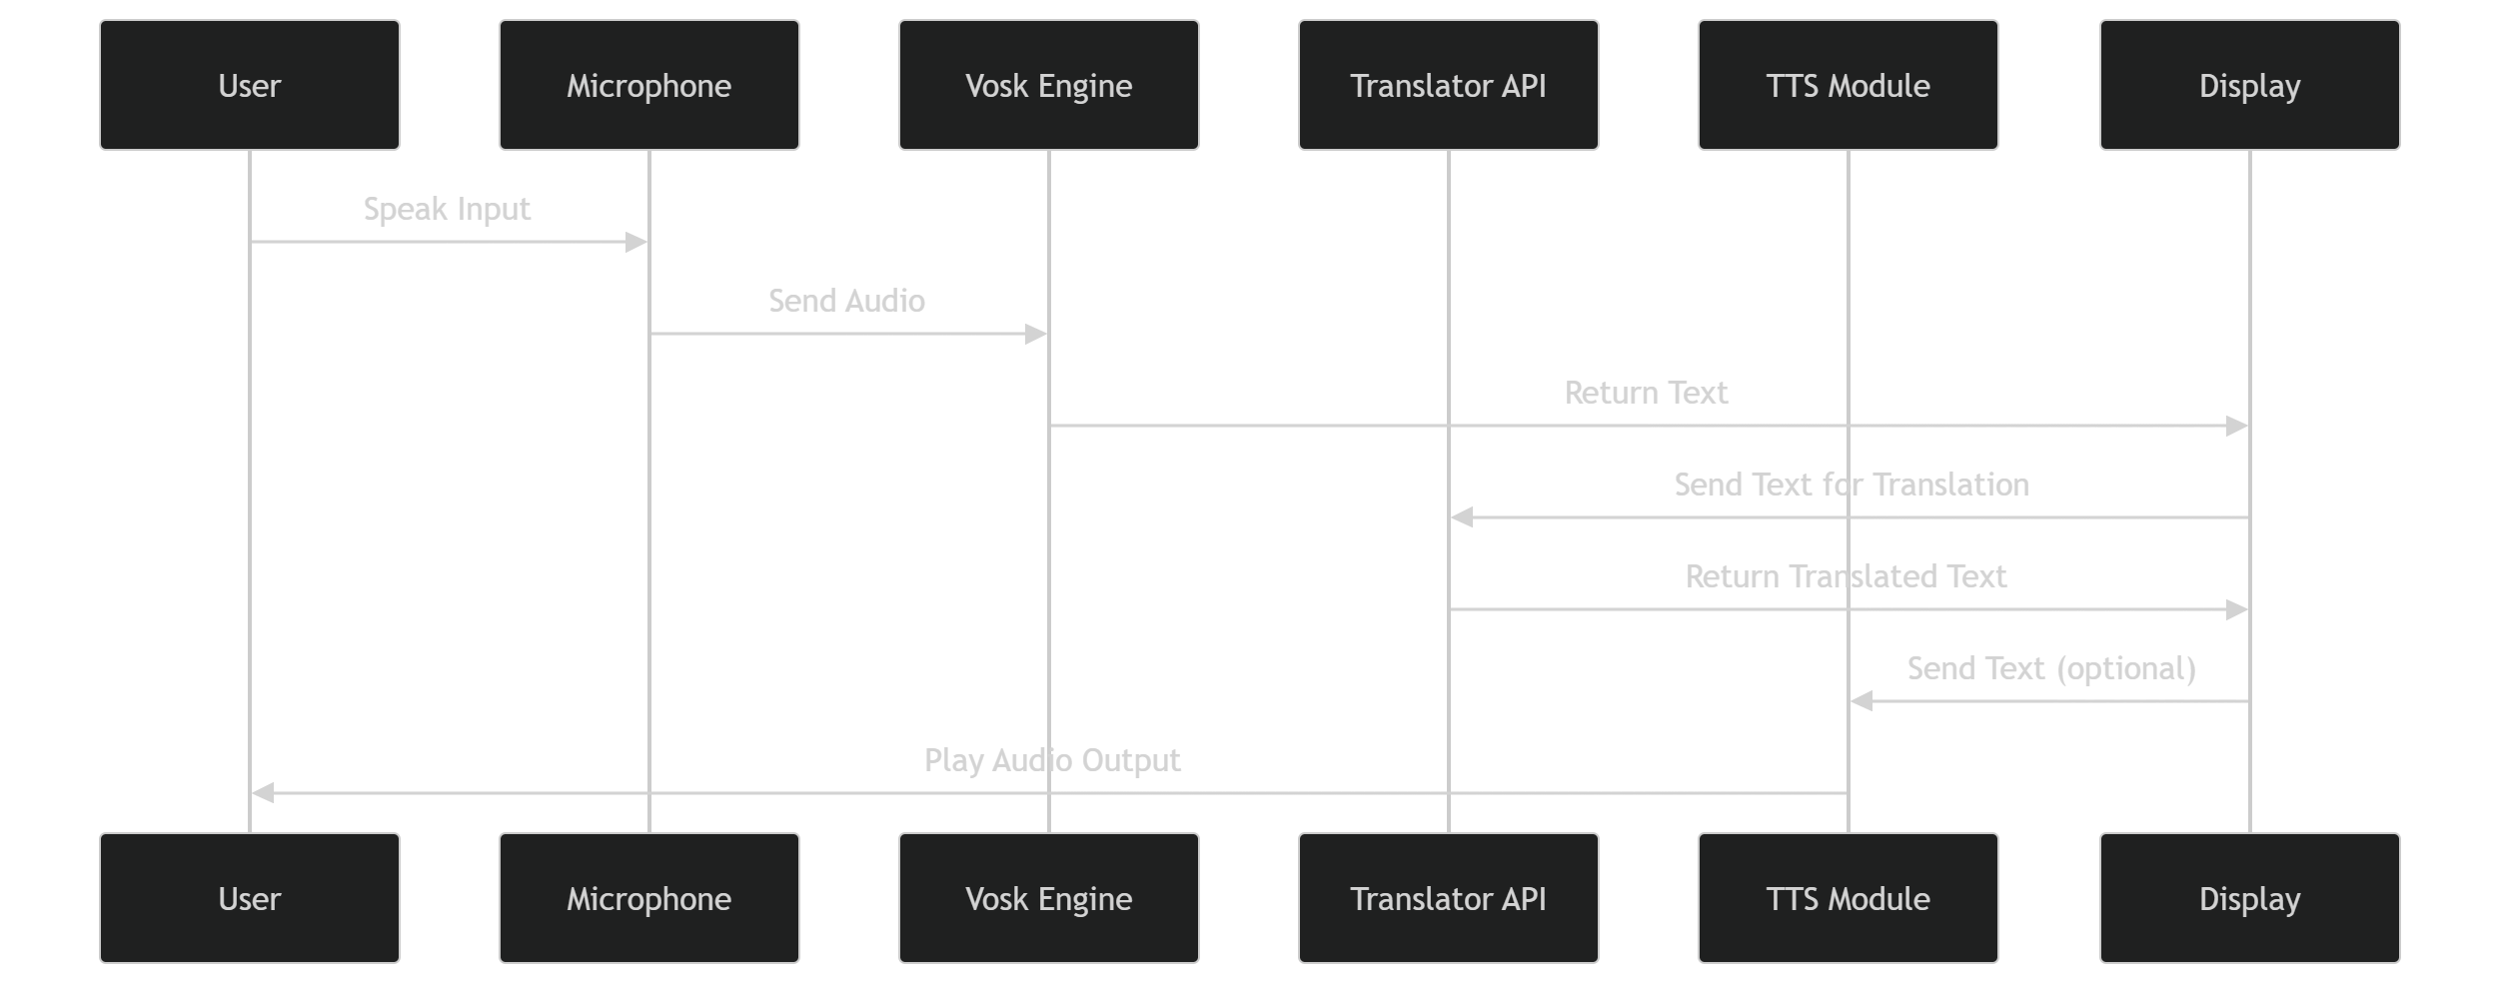
Module Interaction
Input Module: Captures voice input
Speech Recognition Module: Converts audio to text
Translation Module: Converts text into target language
Output Module: Displays and speaks translated result
All modules work sequentially in real-time

Slide 17
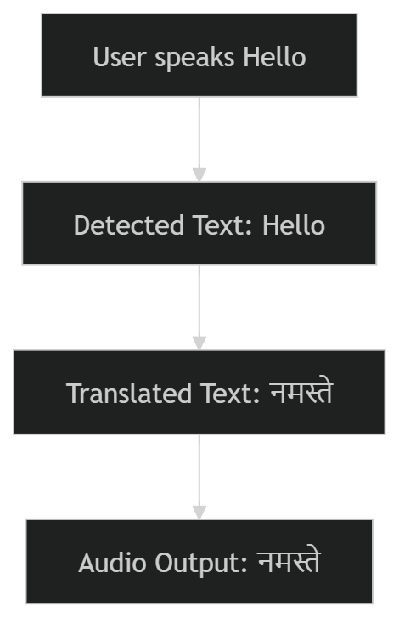
Result
System successfully converts speech to text in real-time
Accurate translation into multiple languages
Supports real-time output with minimal delay
Optional text-to-speech output works correctly
Performs efficiently in normal speaking conditions
Speech Input → Text Output → Translated Text → Audio Output
Example:
Input: "Hello"
Output: "नमस्ते" (Hindi)

Slide 18
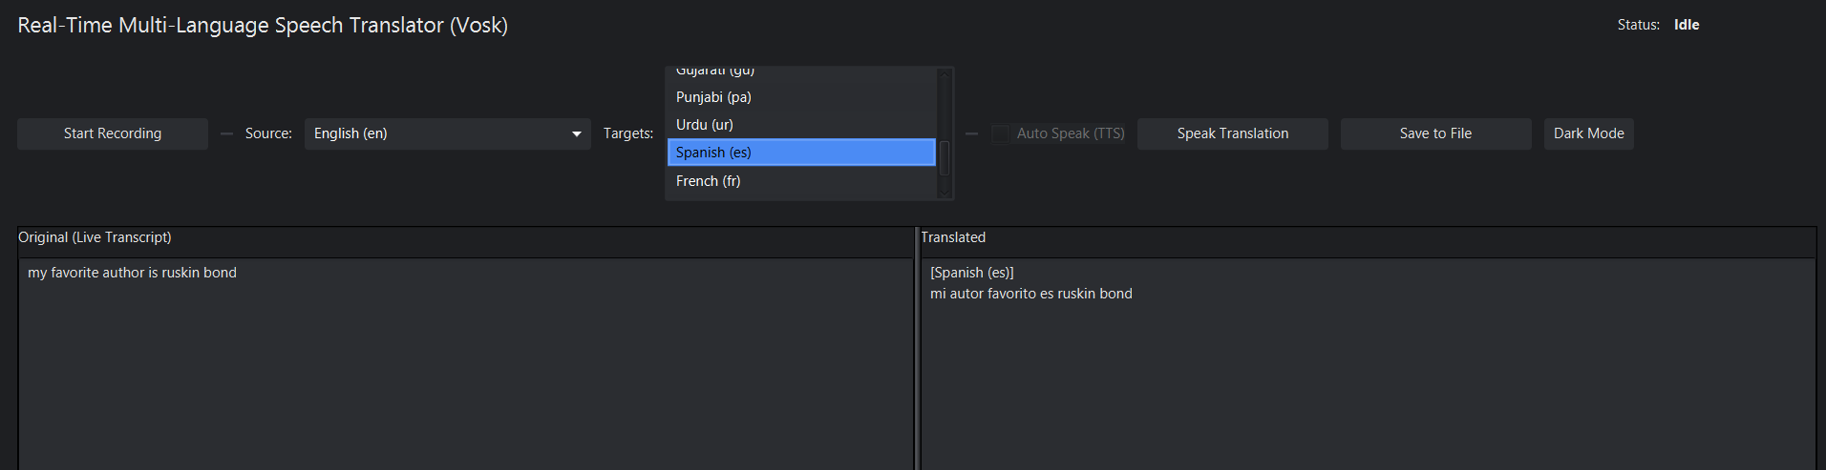
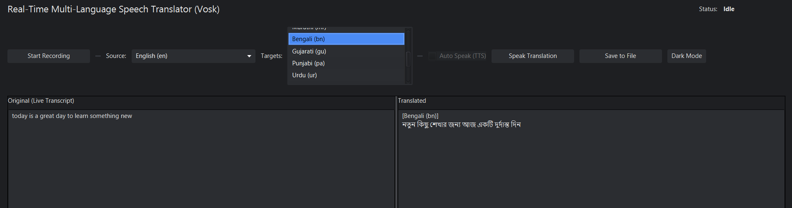
Result

Slide 19
Outcome
Successfully developed a real-time multilingual speech translator
Achieved accurate speech-to-text conversion using Vosk
Implemented multi-language translation with real-time output
Integrated text-to-speech for audio output
System works efficiently with low latency and good accuracy

Slide 20
References
Vosk API Documentation – https://alphacephei.com/vosk/
Kaldi Speech Recognition Toolkit – https://kaldi-asr.org/
LibreTranslate API – https://libretranslate.com/
Java Documentation – https://docs.oracle.com/javase/
Rabiner, L. (1989). A Tutorial on Hidden Markov Models and Selected Applications in Speech Recognition

Slide 21
Thank You

